Slide 1
XGBoost
XGBoost Test Accuracy: 0.4771
XGBoost Test Precision: 0.4395
XGBoost Test Recall: 0.4771
XGBoost Test F1 Score: 0.4519

Slide 2
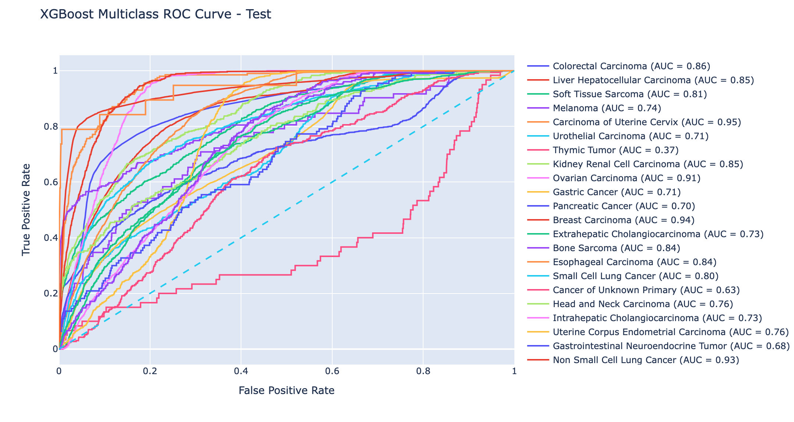

Slide 3
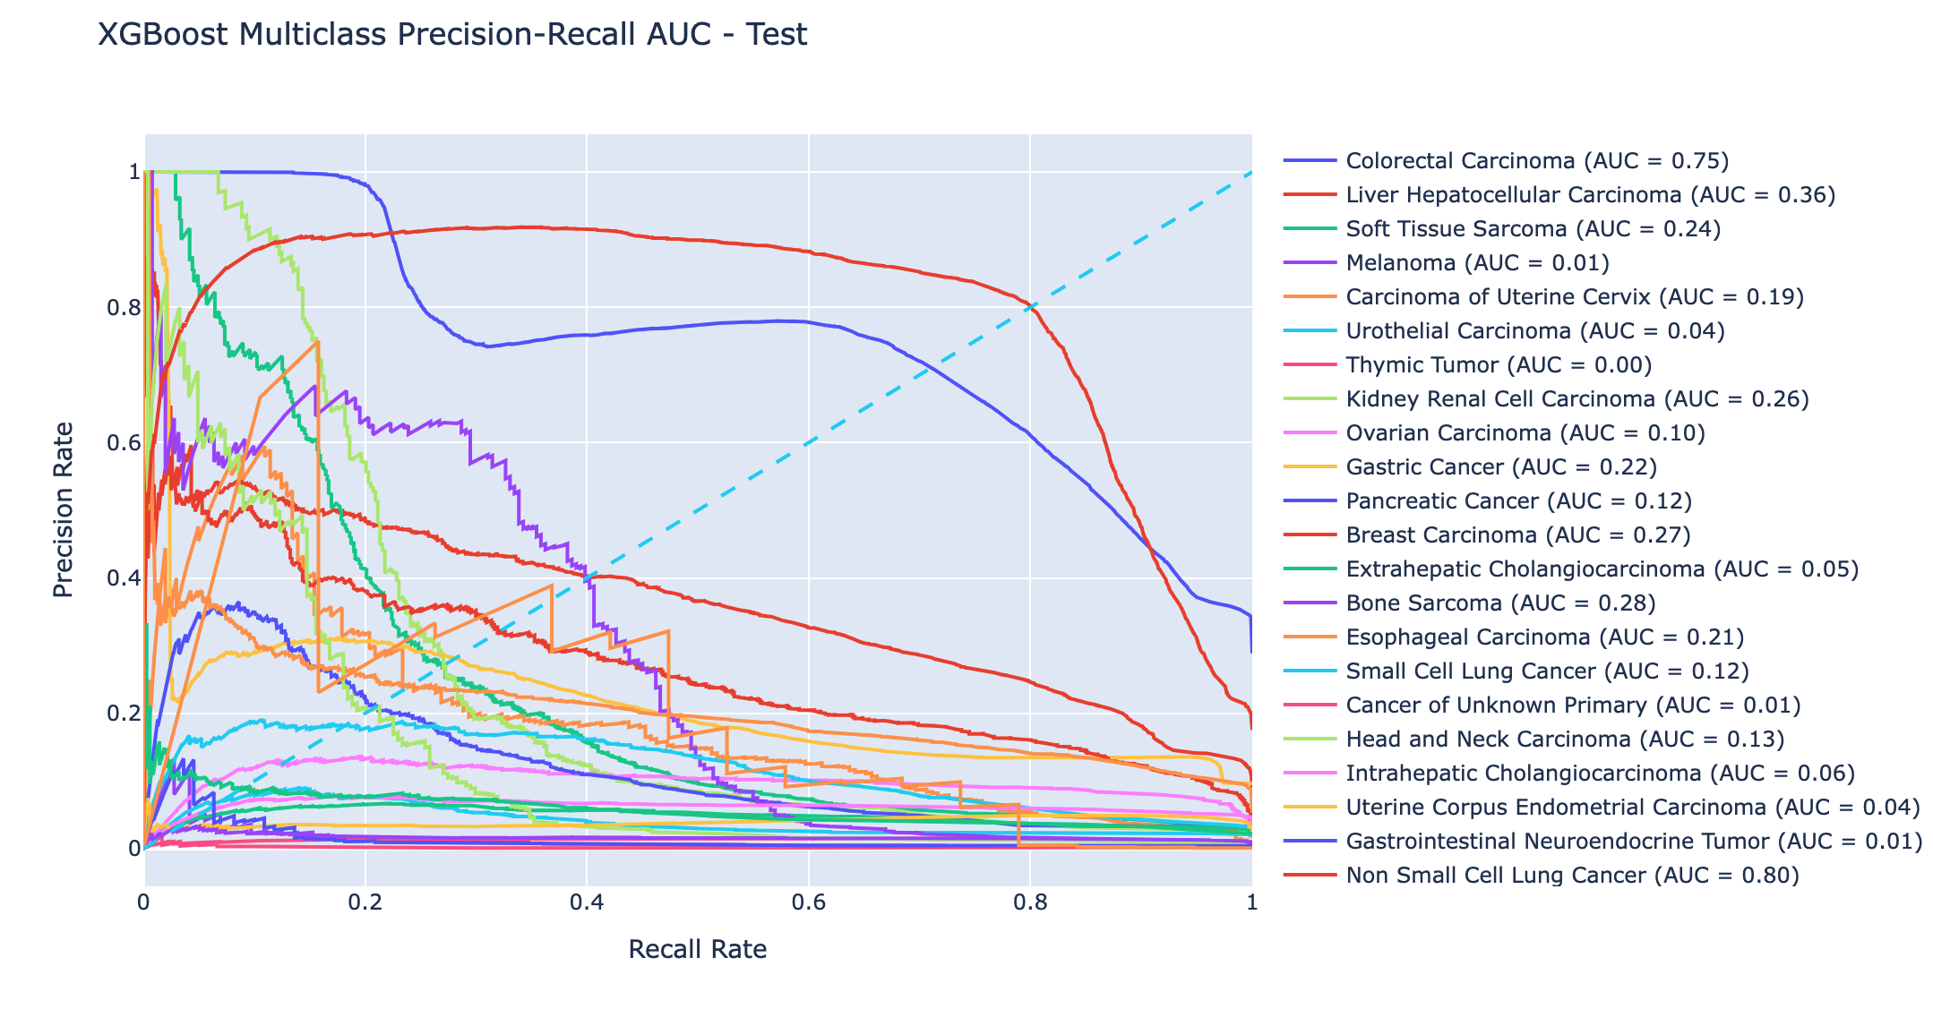

Slide 4
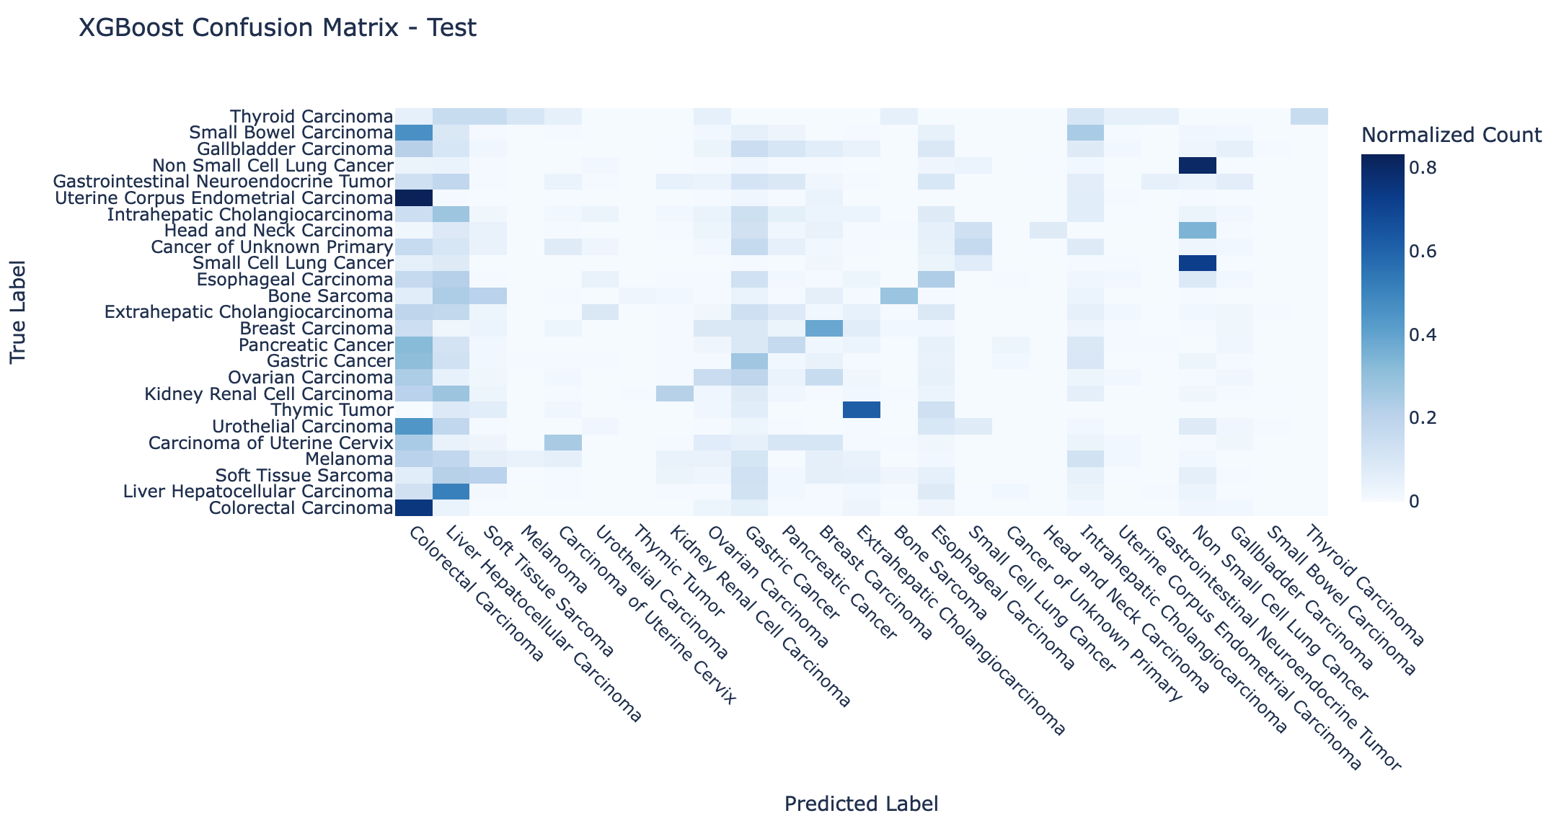

Slide 5
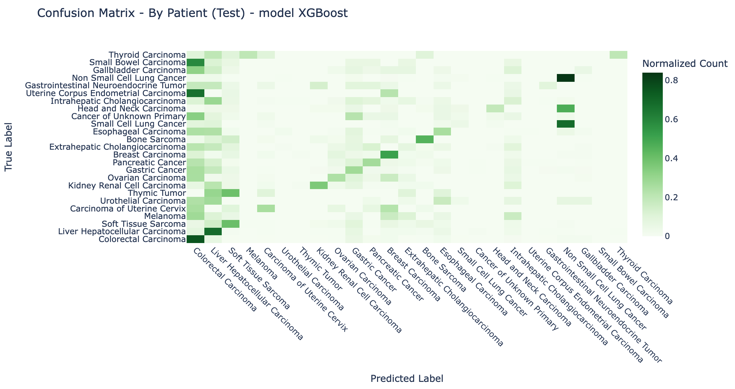

Slide 6
Random Forest
Random Forest Test Accuracy: 0.4811
Random Forest Test Precision: 0.4261
Random Forest Test Recall: 0.4811
Random Forest Test F1 Score: 0.4393

Slide 7
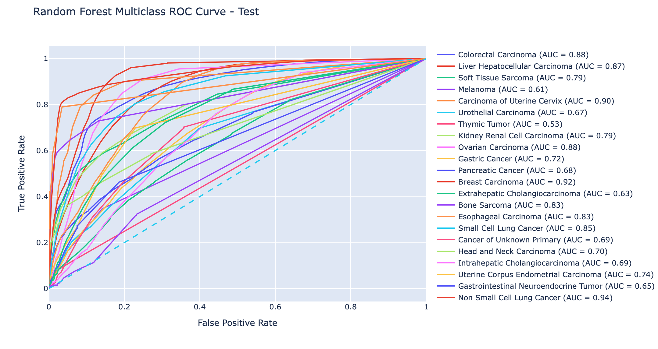

Slide 8
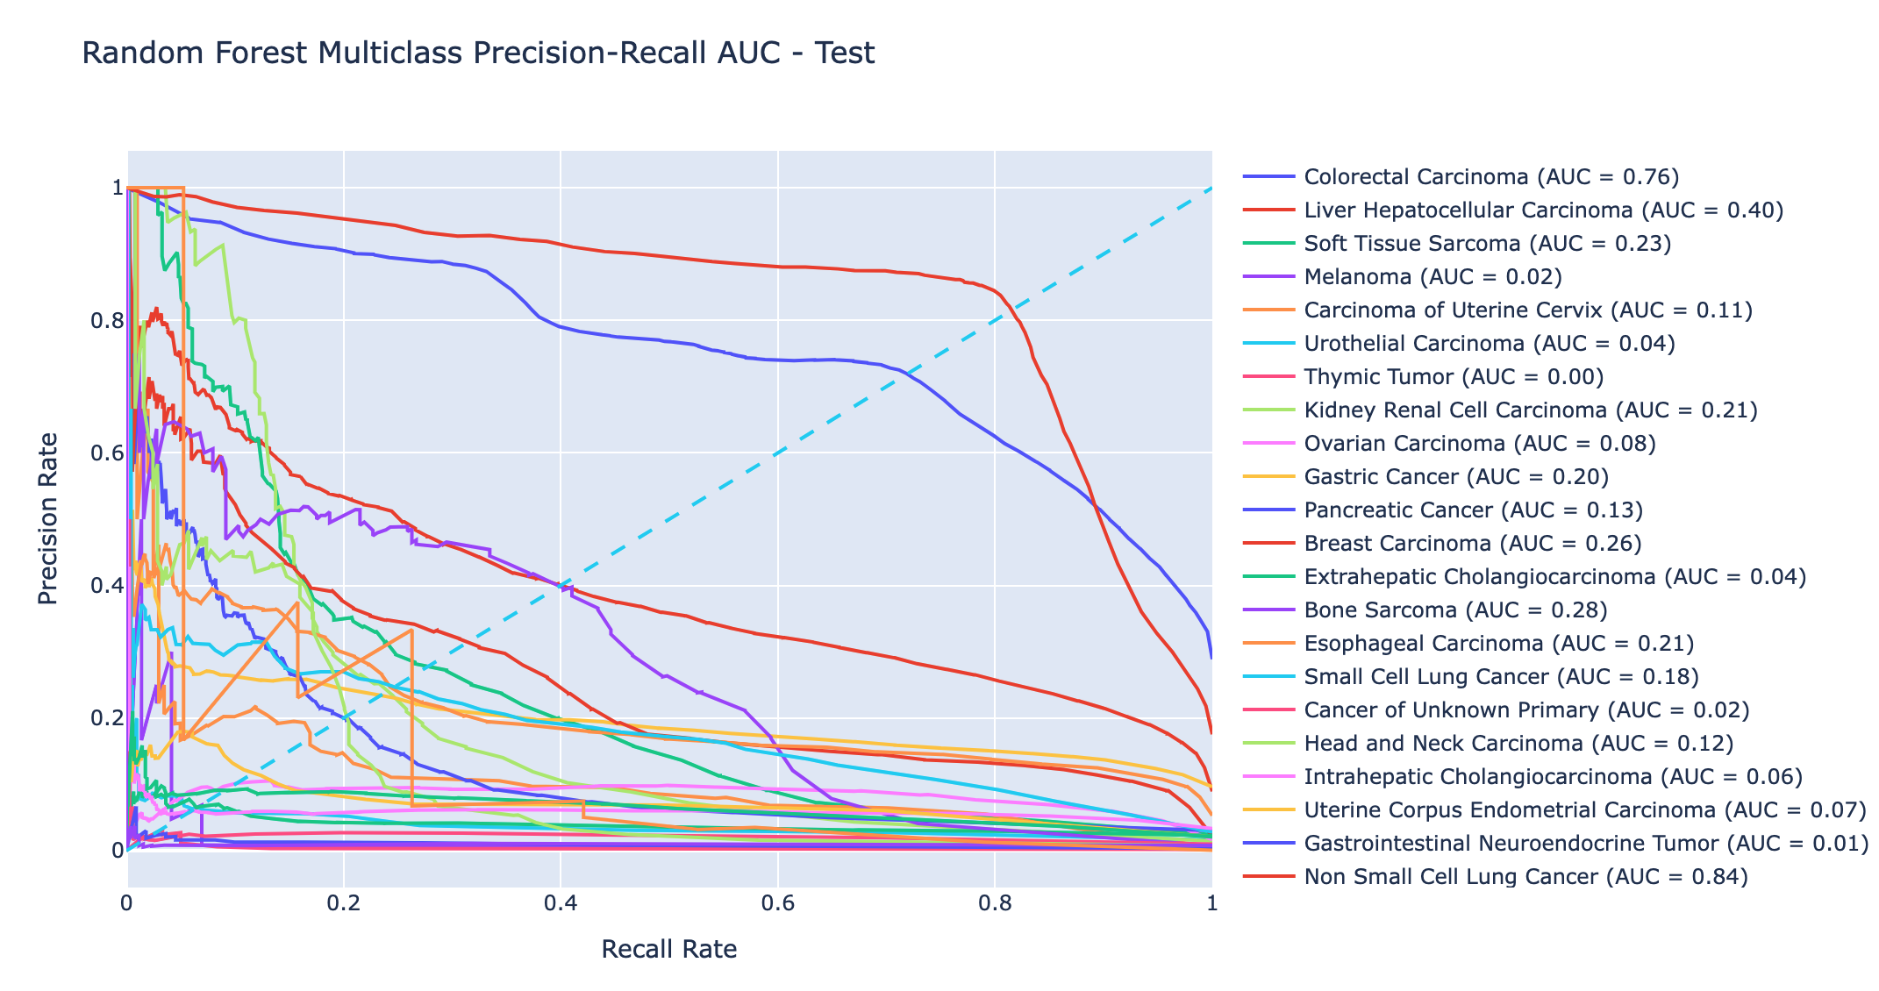

Slide 9
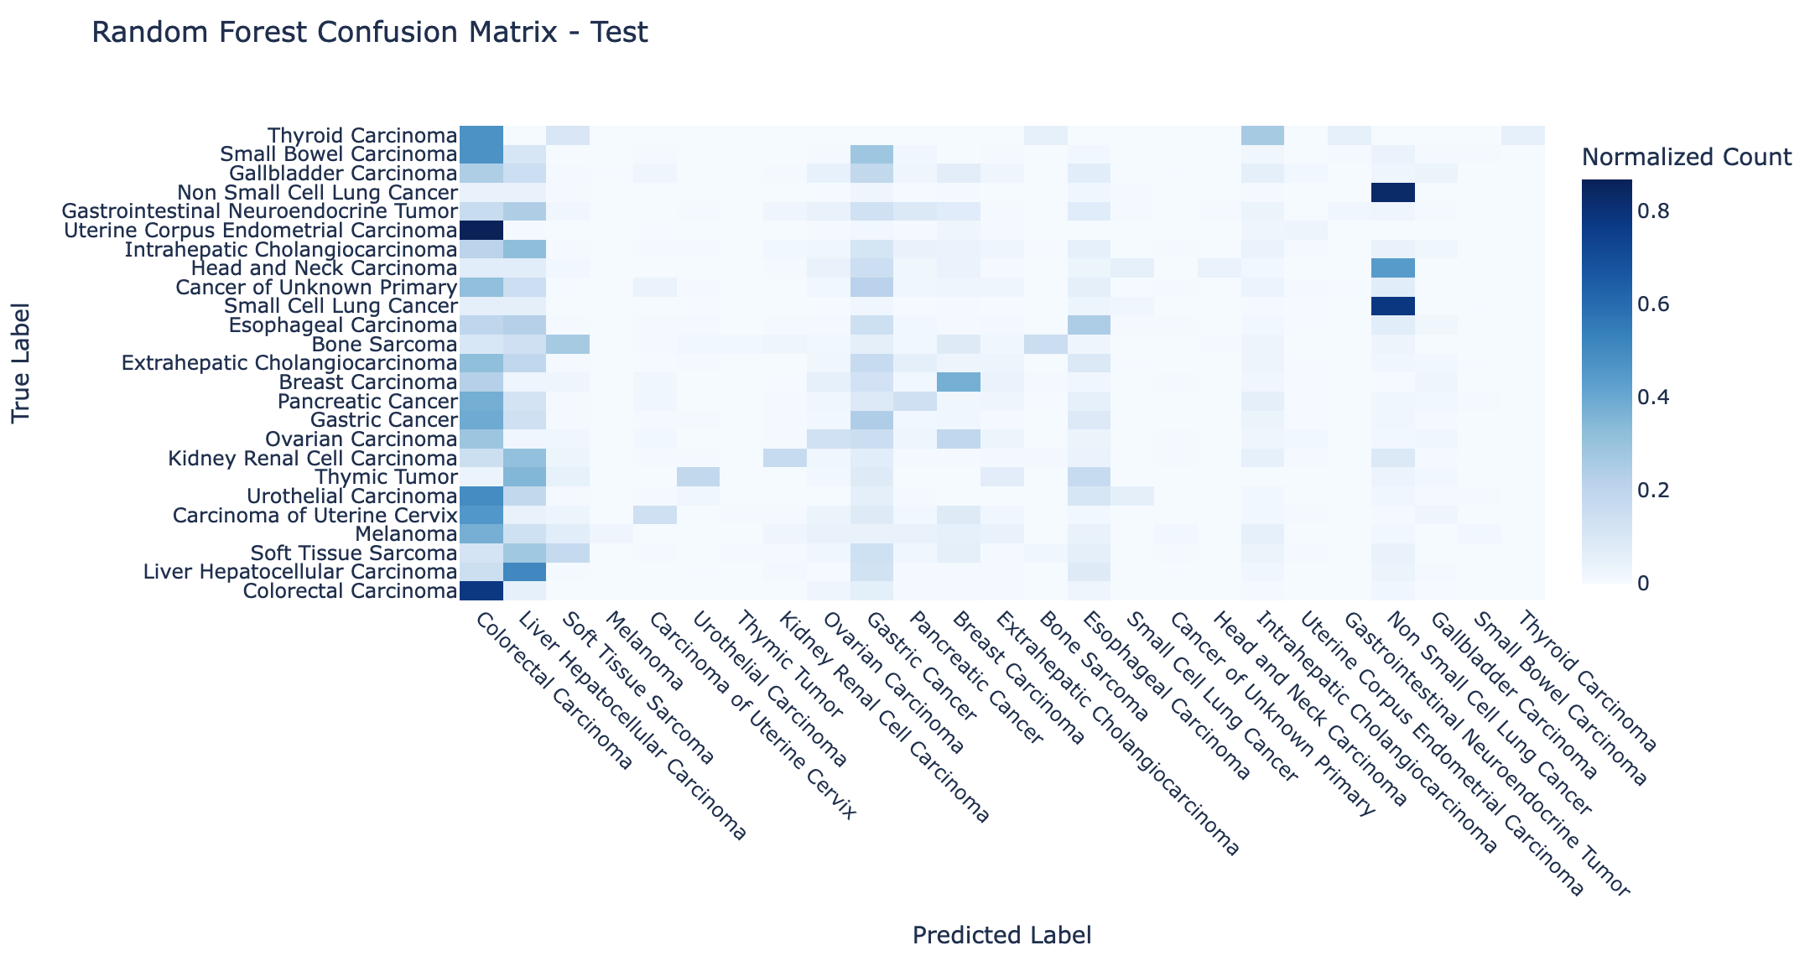

Slide 10
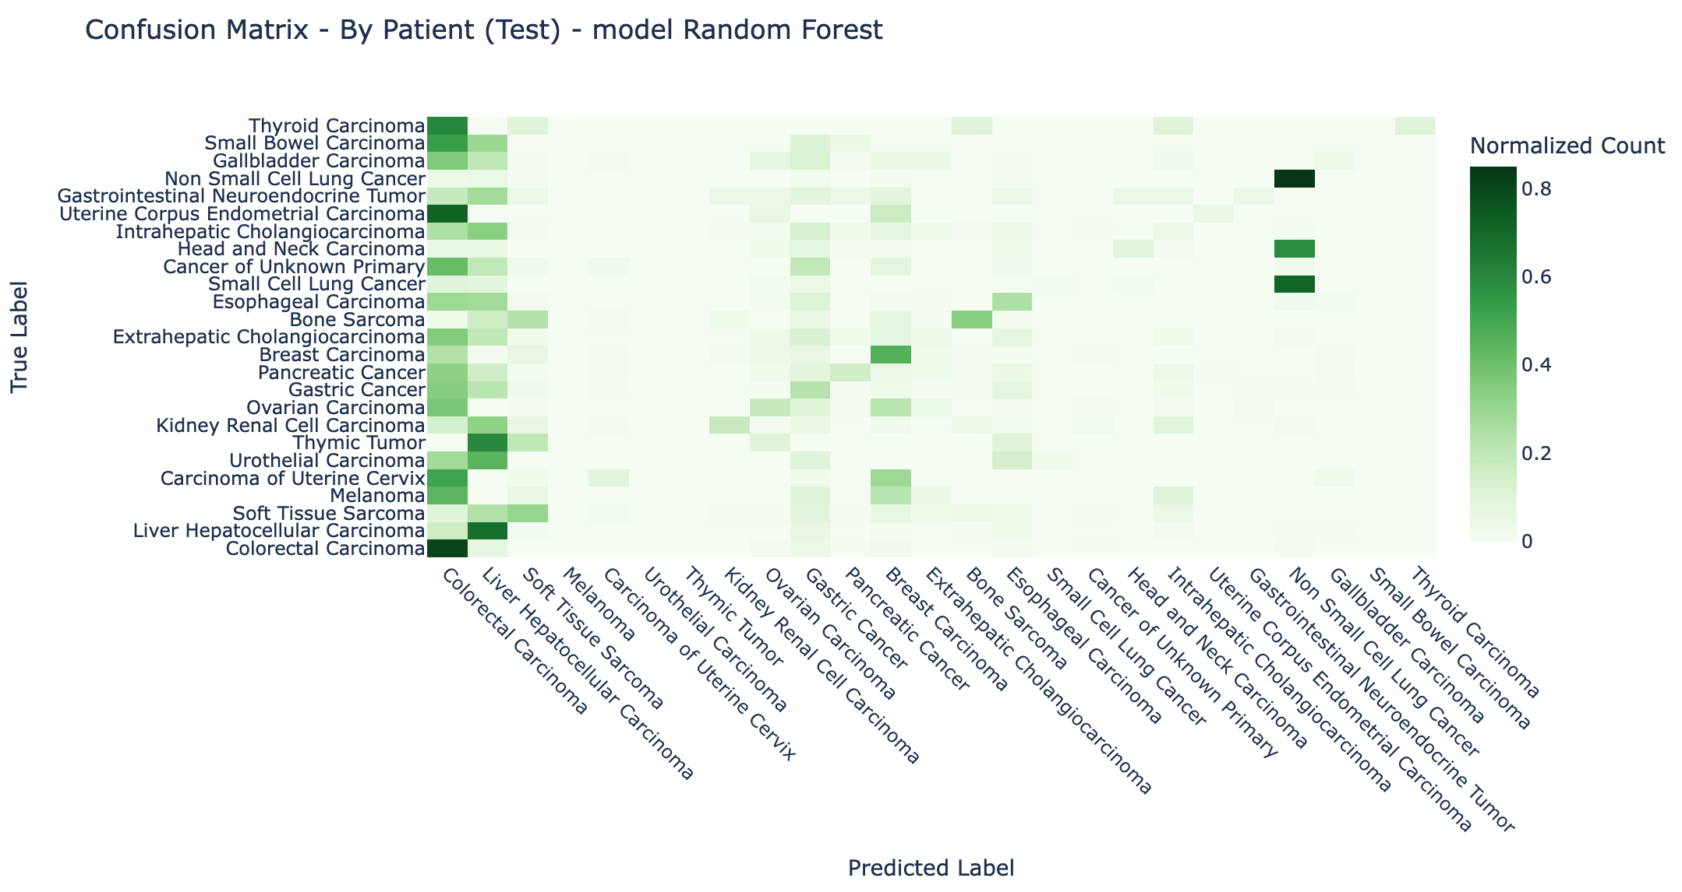

Slide 11
Decision Tree
Decision Tree Test Accuracy: 0.3827
Decision Tree Test Precision: 0.3843
Decision Tree Test Recall: 0.3827
Decision Tree Test F1 Score: 0.3828

Slide 12
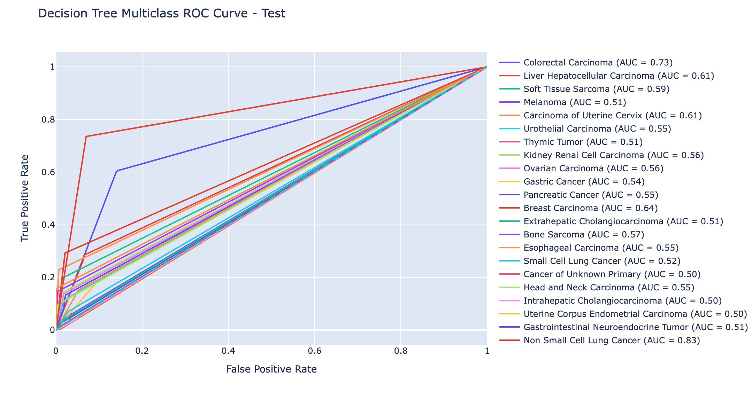

Slide 13
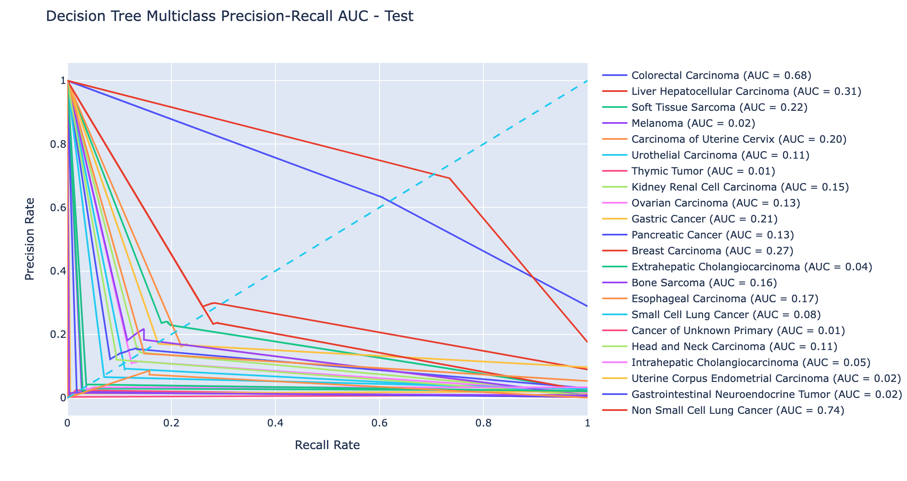

Slide 14
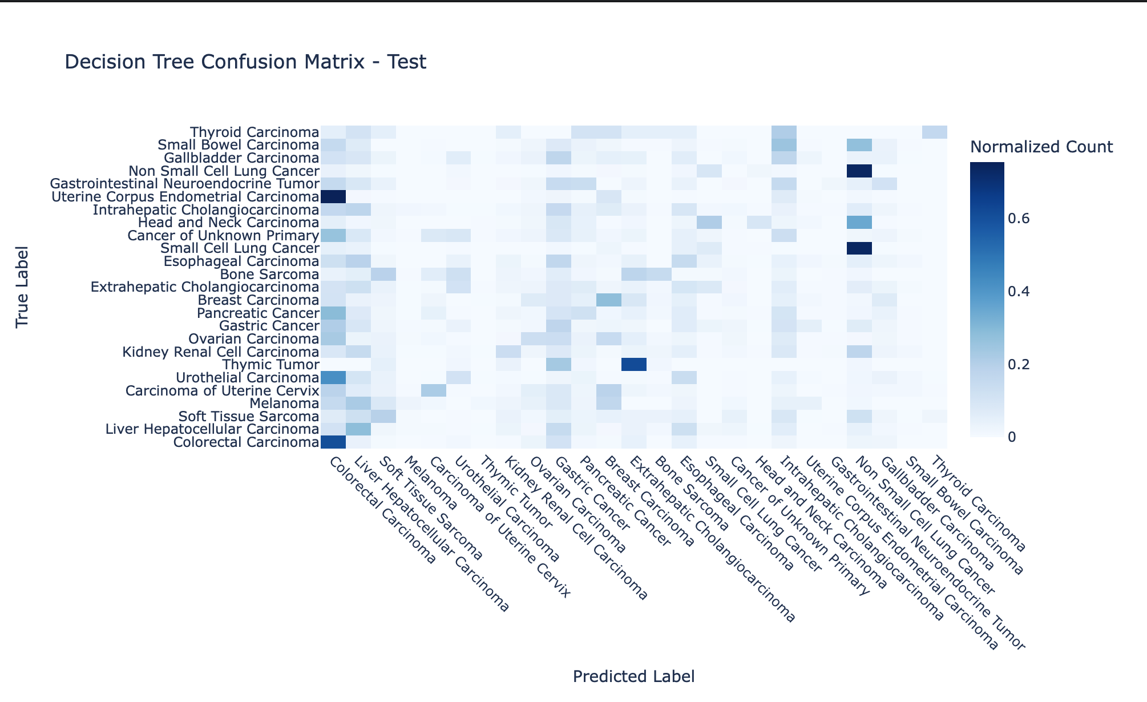

Slide 15
